Slide 1
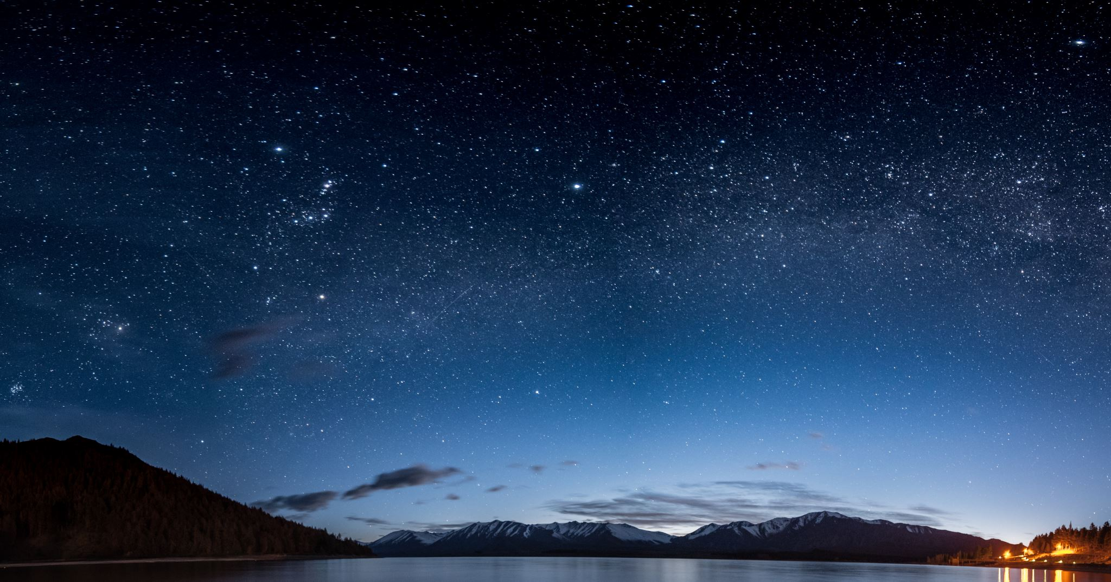
Stellar Spectroscopy and the Doppler Effect
NUS High Astronomy Club
Senior Theory
24 February 2022

Slide 2
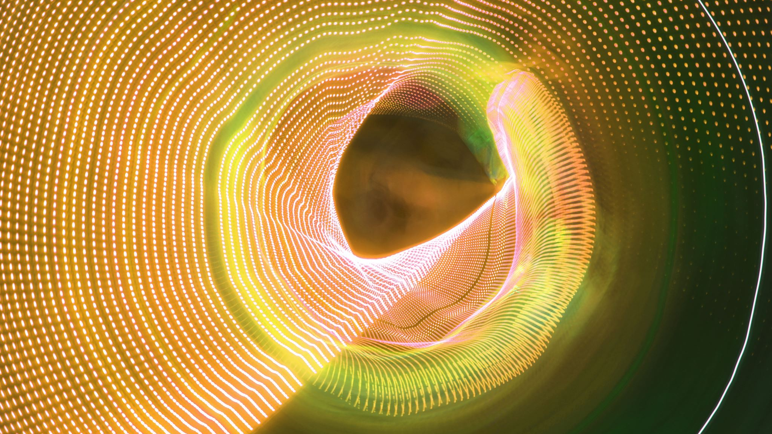
A Brief Recap On Waves and Electromagnetic Radiation
0.1 Waves
0.2 Electromagnetic Waves
0.3 The EM Spectrum

Slide 3
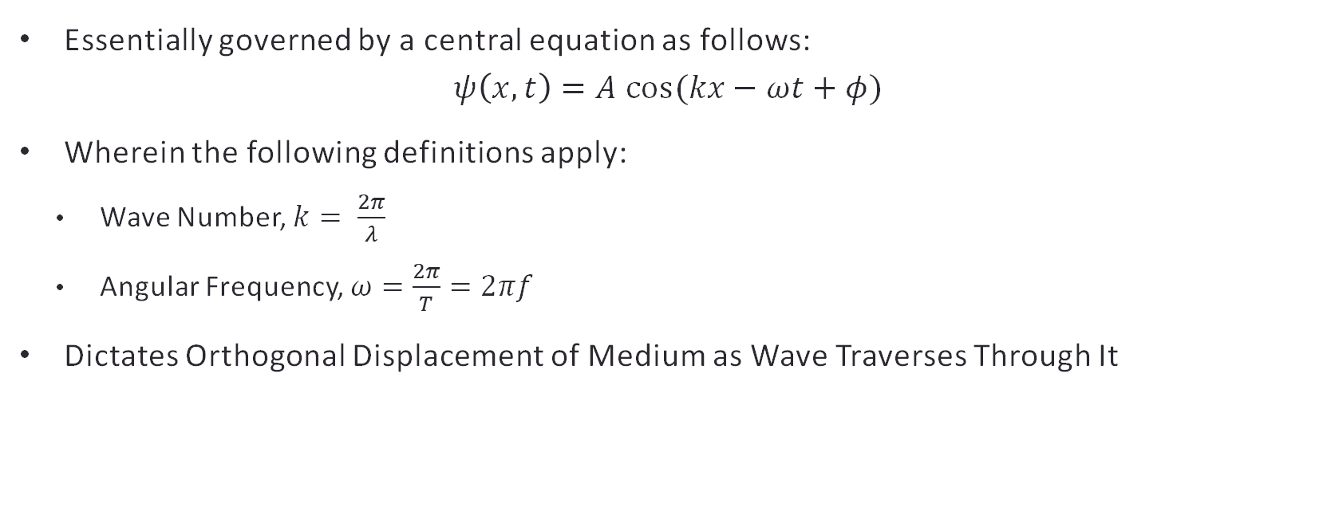
Waves
Essentially governed by a central equation as follows:
$$ψ\left(x,t\right)=A cos(kx−ωt+φ)$$
Wherein the following definitions apply:
Wave Number, $k= \frac{2π}{λ}$
Angular Frequency, $ω=\frac{2π}{T}=2πf$
Dictates Orthogonal Displacement of Medium as Wave Traverses Through It

Slide 4
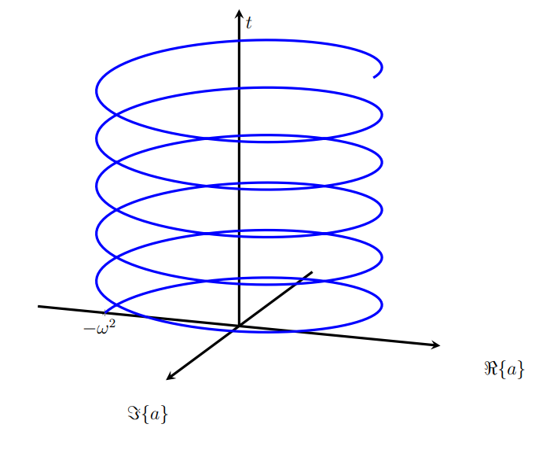
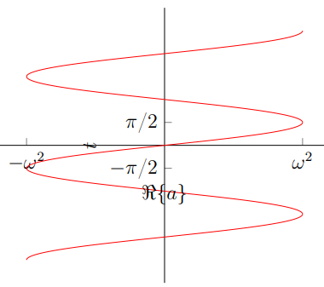
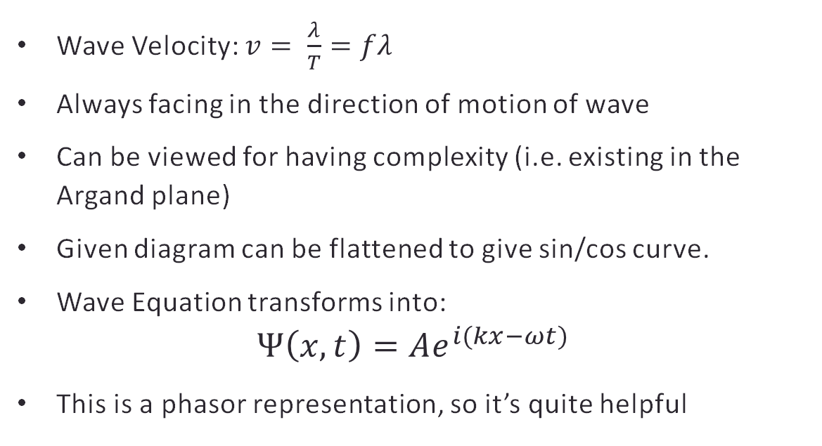
Waves
Wave Velocity: $v= \frac{λ}{T}=fλ$
Always facing in the direction of motion of wave
Can be viewed for having complexity (i.e. existing in the Argand plane)
Given diagram can be flattened to give sin/cos curve.
Wave Equation transforms into:
$$Ψ\left(x, t\right)=Ae^{i(kx−ωt)}$$
This is a phasor representation, so it’s quite helpful

Slide 5
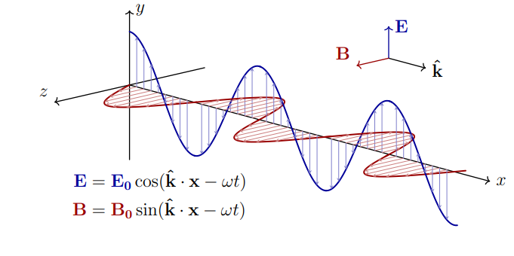
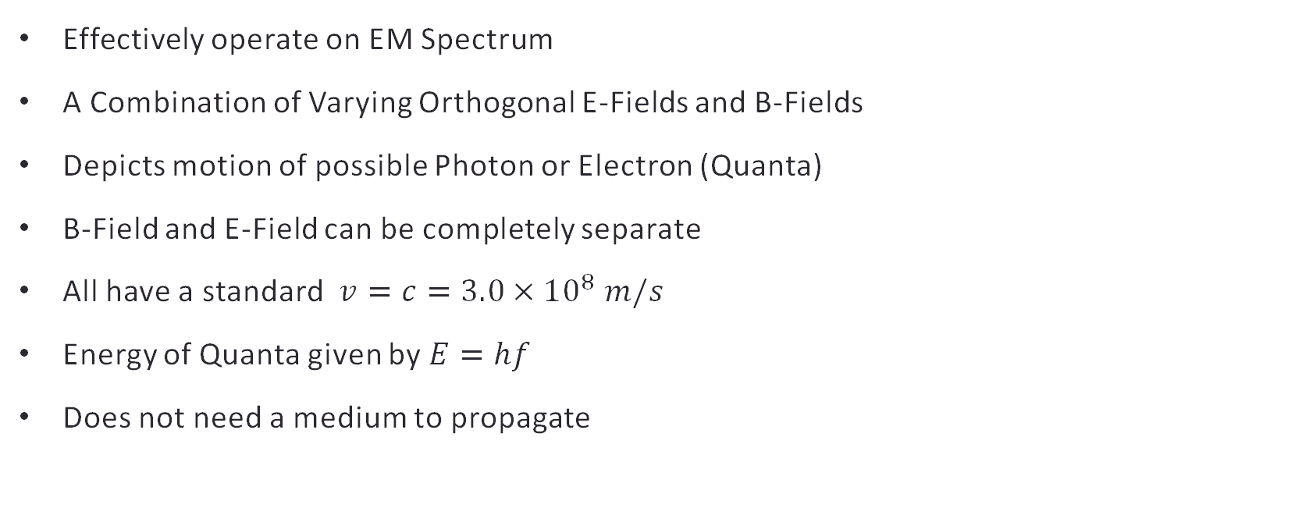
Electromagnetic Waves
Effectively operate on EM Spectrum
A Combination of Varying Orthogonal E-Fields and B-Fields
Depicts motion of possible Photon or Electron (Quanta)
B-Field and E-Field can be completely separate
All have a standard $v=c=3.0×{10}^{8} m/s$
Energy of Quanta given by $E=hf$
Does not need a medium to propagate

Slide 6
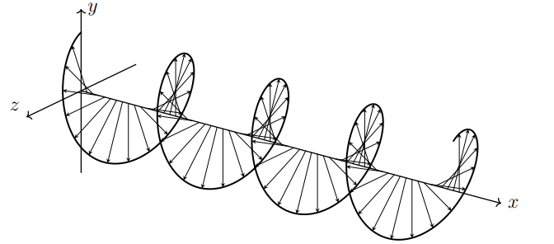
Electromagnetic Waves
Interestingly, in the case of the original image, we get this specific helix created to signify the movement of the photon or electron:

Slide 7
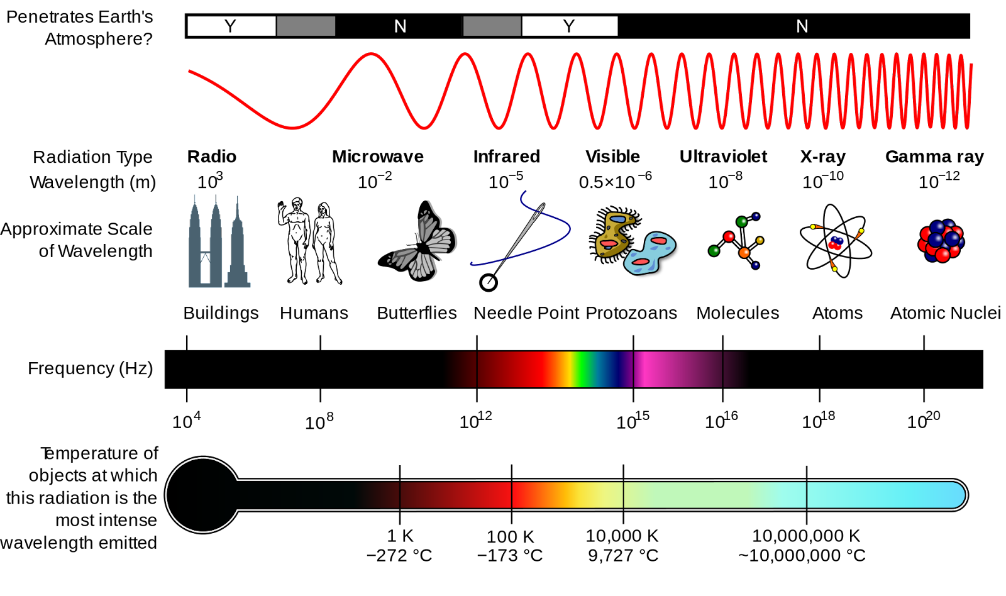
Electromagnetic Spectrum

Slide 8
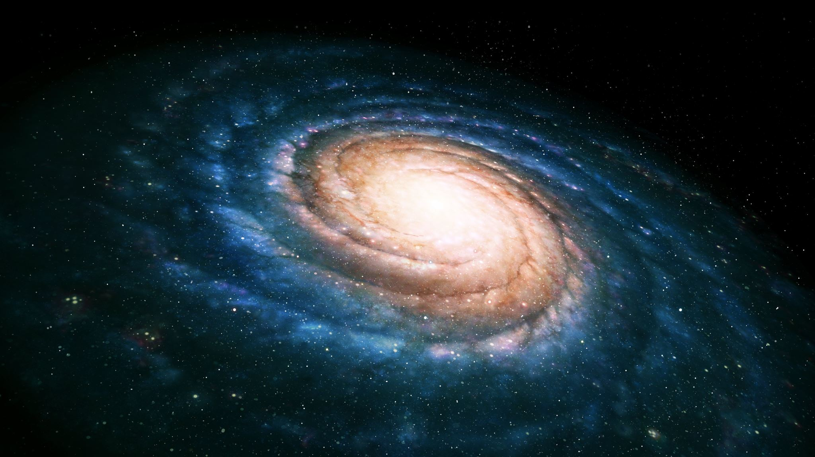
Stellar Spectroscopy And Spectral Lines
1.1 What is Spectroscopy?
1.2 Continuous, Absorption and Emission Spectra
1.3 Rydberg’s Formula

Slide 9
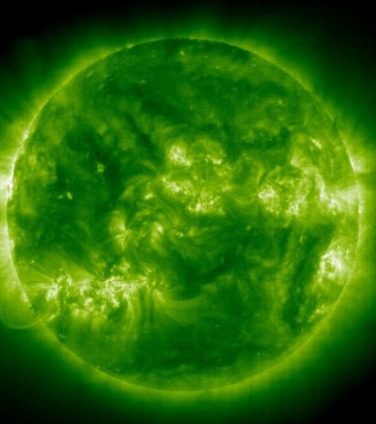
Stellar Spectroscopy
Based on the relative light coming from Deep Space Objects (DSOs)
Can be used to identify electronic configurations, ionizing energy, movement, composition, pressure and temperature
Cool way of detecting interesting phenomena like The Iron Sun
pictured, APOD on September 29th, 2001
eleven times ionized iron emissions from the Sun, in ultraviolet light

Slide 10
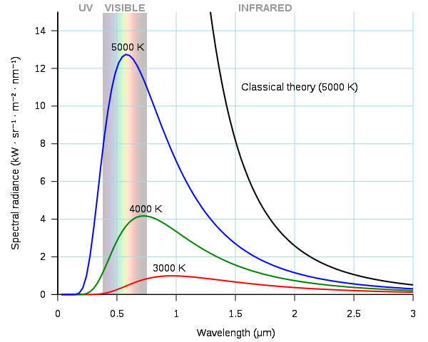
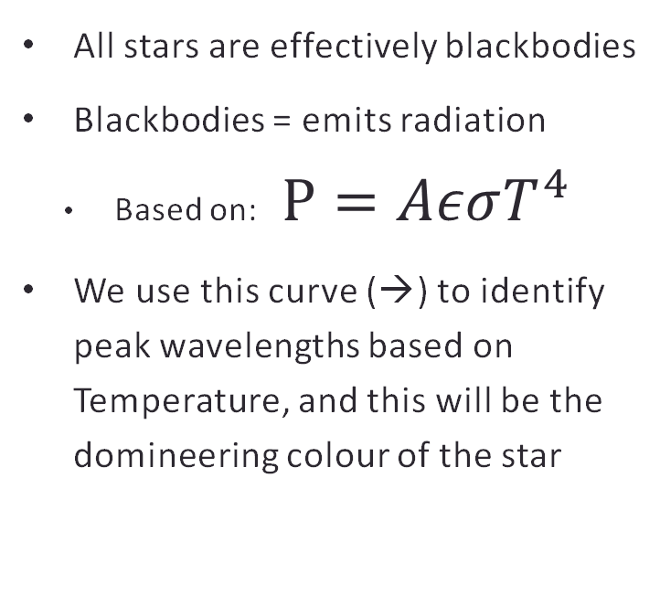
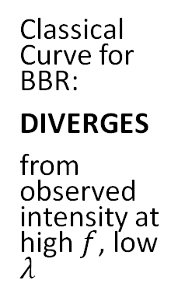
Spectral Distribution Intensity
All stars are effectively blackbodies
Blackbodies = emits radiation
Based on: $P=AεσT^{4}$
We use this curve (→) to identify peak wavelengths based on Temperature, and this will be the domineering colour of the star
Classical Curve for BBR:
DIVERGES
from observed intensity at high $f$, low $λ$

Slide 11
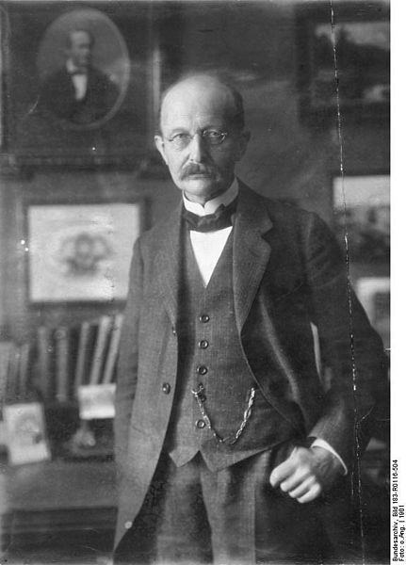
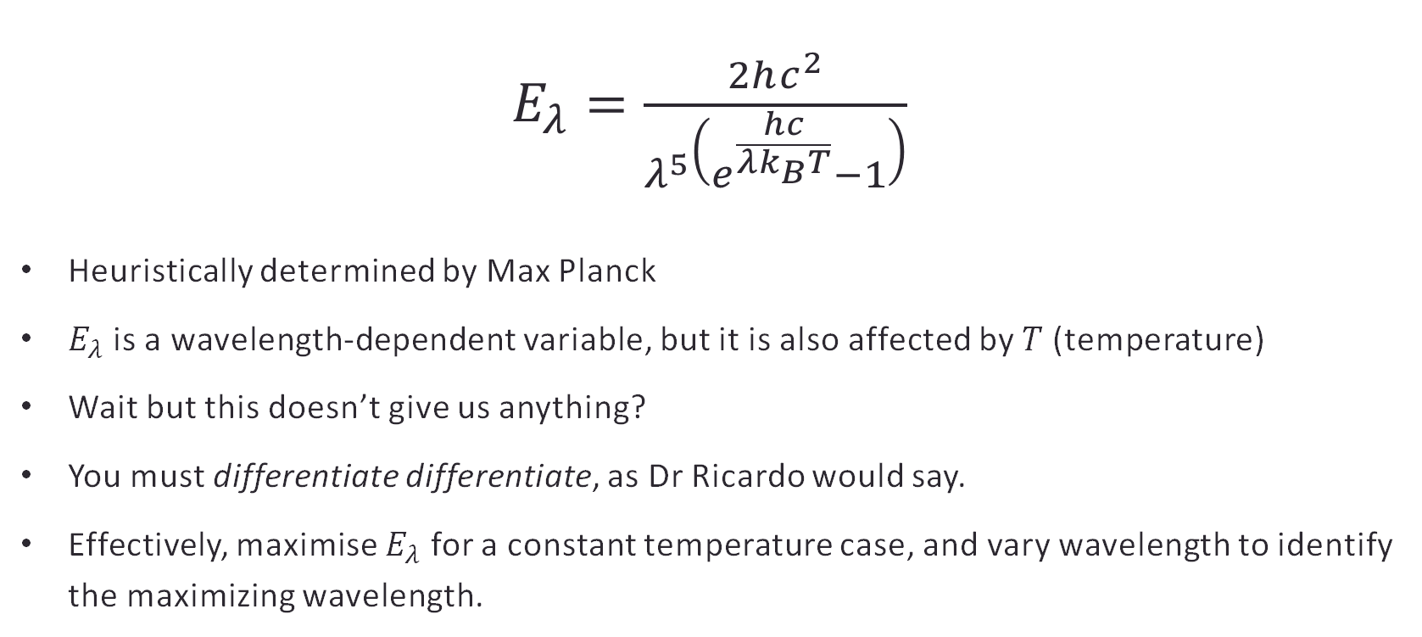
Planck’s Law of Spectral Emission Intensity
$E_{λ}=\frac{2hc^{2}}{λ^{5}\left(e^{\frac{hc}{λk_{B}T}}−1\right)}$
Heuristically determined by Max Planck
$E_{λ}$ is a wavelength-dependent variable, but it is also affected by 𝑇 (temperature)
Wait but this doesn’t give us anything?
You must differentiate differentiate, as Dr Ricardo would say.
Effectively, maximise $E_{λ}$ for a constant temperature case, and vary wavelength to identify the maximizing wavelength.

Slide 12
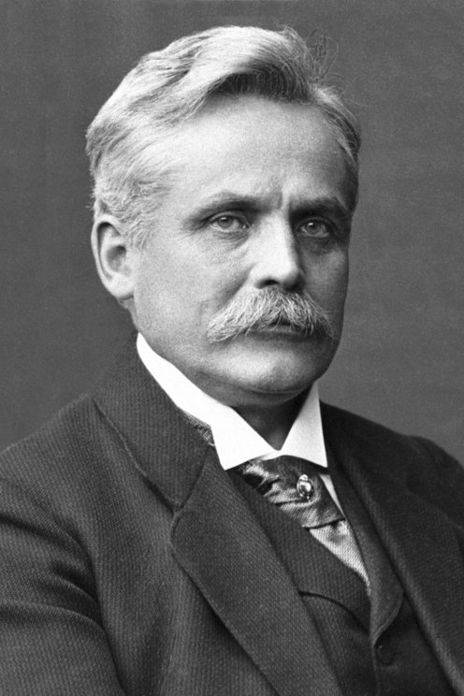
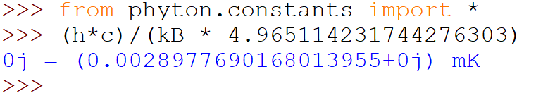
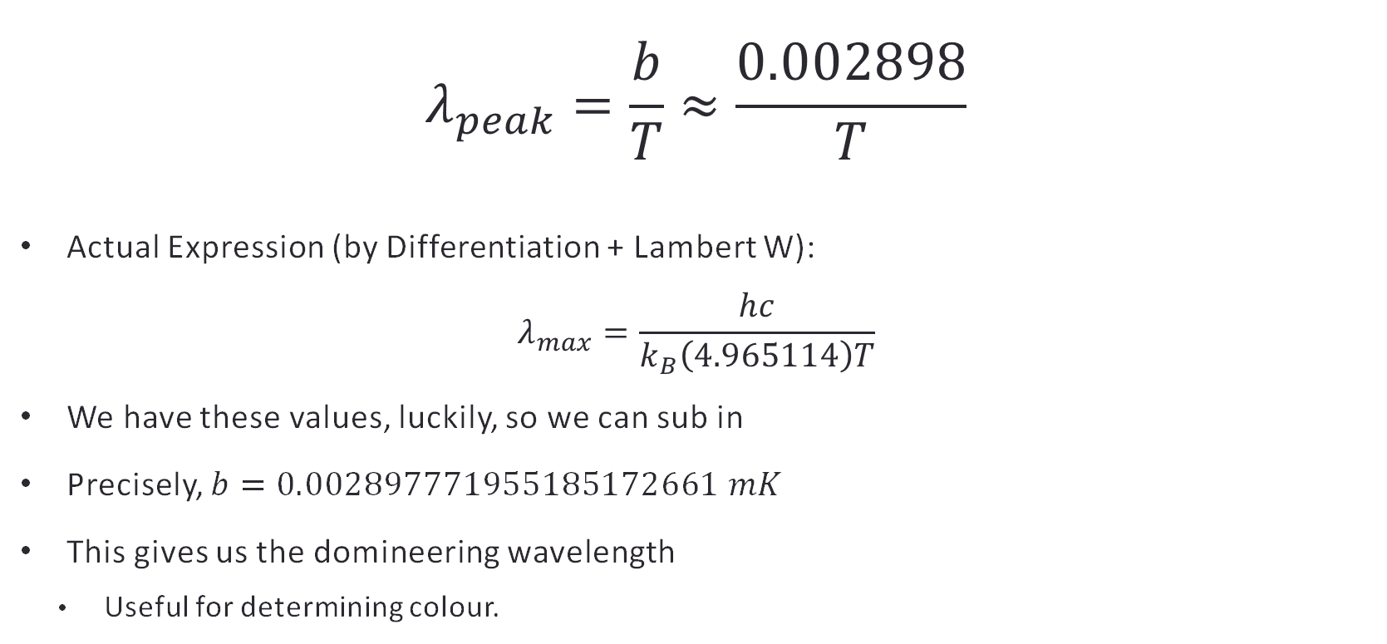
Wien’s Displacement Formula
$$λ_{peak}=\frac{b}{T}≈\frac{0.002898}{T}$$
Actual Expression (by Differentiation + Lambert W):
$$λ_{max}=\frac{hc}{k_{B}\left(4.965114\right)T}$$
We have these values, luckily, so we can sub in
Precisely, $b=0.002897771955185172661 mK$
This gives us the domineering wavelength
Useful for determining colour.

Slide 13
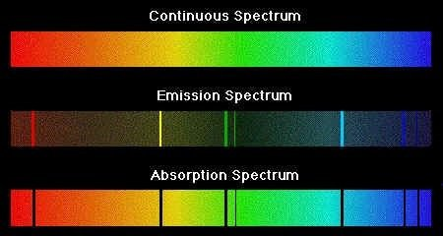
The Three Spectra

Slide 14
Continuous Spectrum
When Newton did his famous experiment with a prism and sunlight, he noted that the Sun produced a “rainbow” of colours.
This is the continuous spectrum.
Stars specifically release continuous spectrum-based lights.
Incandescent Lights and Filaments too.

Slide 15
Emission Spectrum
When we measure prismatic separation of light from a DSO like Messier 42 (Orion Nebula), we however obtain this:
This is the emission spectrum.
If a gas cloud is heated sufficiently, it can emit its own wavelength of radiation (at specific wavelengths).
Depends on the electronic configuration, composition, pressure and temperature of the gas and movement of source relative to observer.

Slide 16
Absorption Spectrum
When we measure prismatic separation of light from an incandescent/stellar source passing through a gas cloud, we obtain this:
This is the absorption spectrum.
Dark lines represent light that has been absorbed by the gas cloud.
Dark lines situated at exactly the points where the emissions in the emission spectrum were shown.

Slide 17
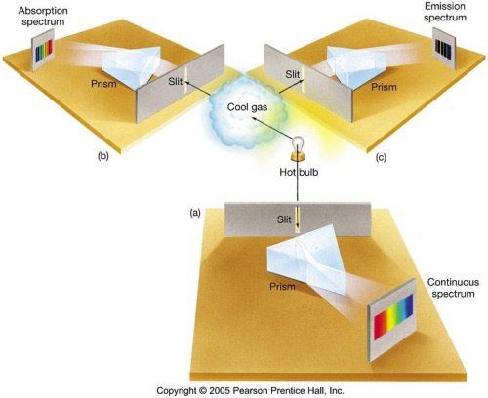
Summary of Spectra
Continuous Spectrum from Incandescent/ Stellar Sources
Emission Spectrum from DSOs/ Gas Clouds/ Fluorescence Sources
Absorption Spectrum from DSOs/ Gas Clouds in front of Incandescent/ Stellar Sources

Slide 18
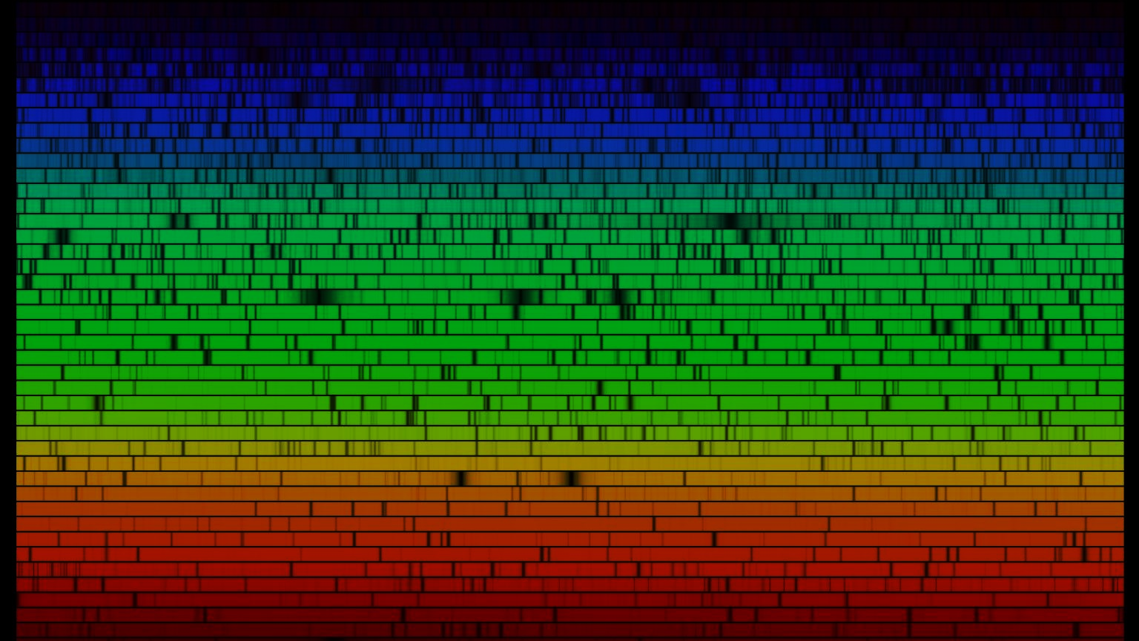
Issues of this System
These Spectra aren’t as cookie cutter, however.
The Sun’s spectrum isn’t actually continuous, it looks like this.
These Spectral Lines are cut-up into strips.
Many elements are depicted here.
We use this to identify abundance and configuration of different elements in the atmosphere (e.g. Helium discovered by spectroscopic analysis of the Sun)

Slide 19
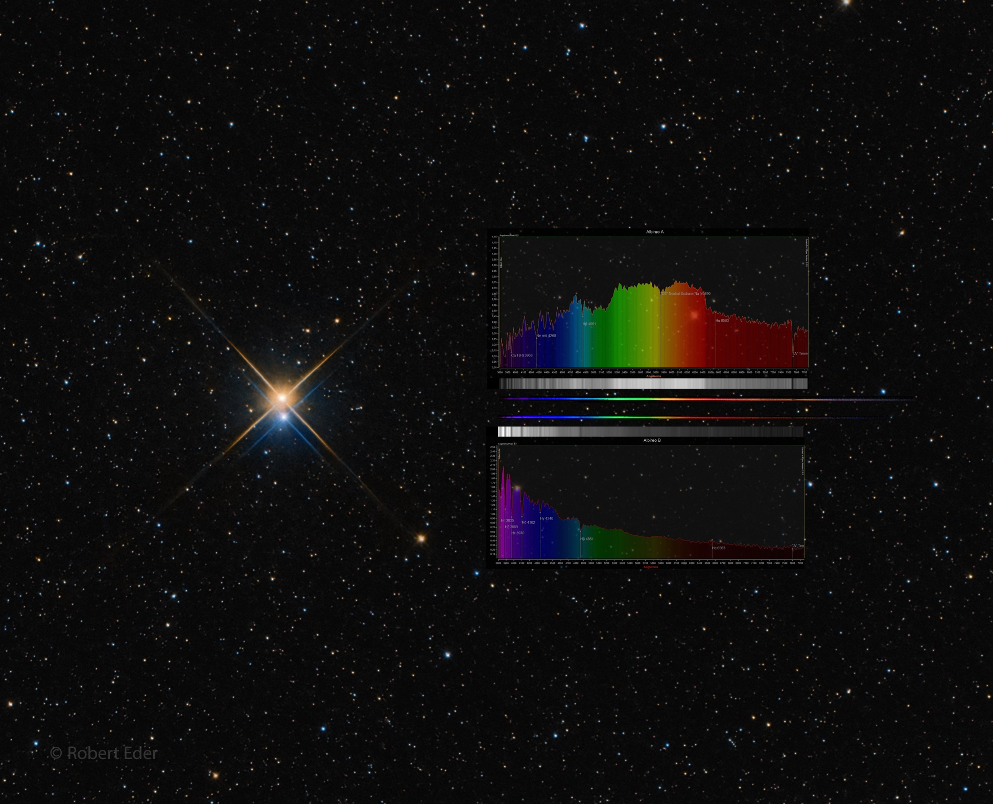
Albireo AB or Beta Cygni (APOD from 24 Feb 2022)
Binary Star System
Albireo A (top): K-type giant star, cooler than the sun, most light emitted is red or yellow
Albireo B (bottom): Main Sequence Star, much hotter than the sun, most light emitted is blue or violet

Slide 20
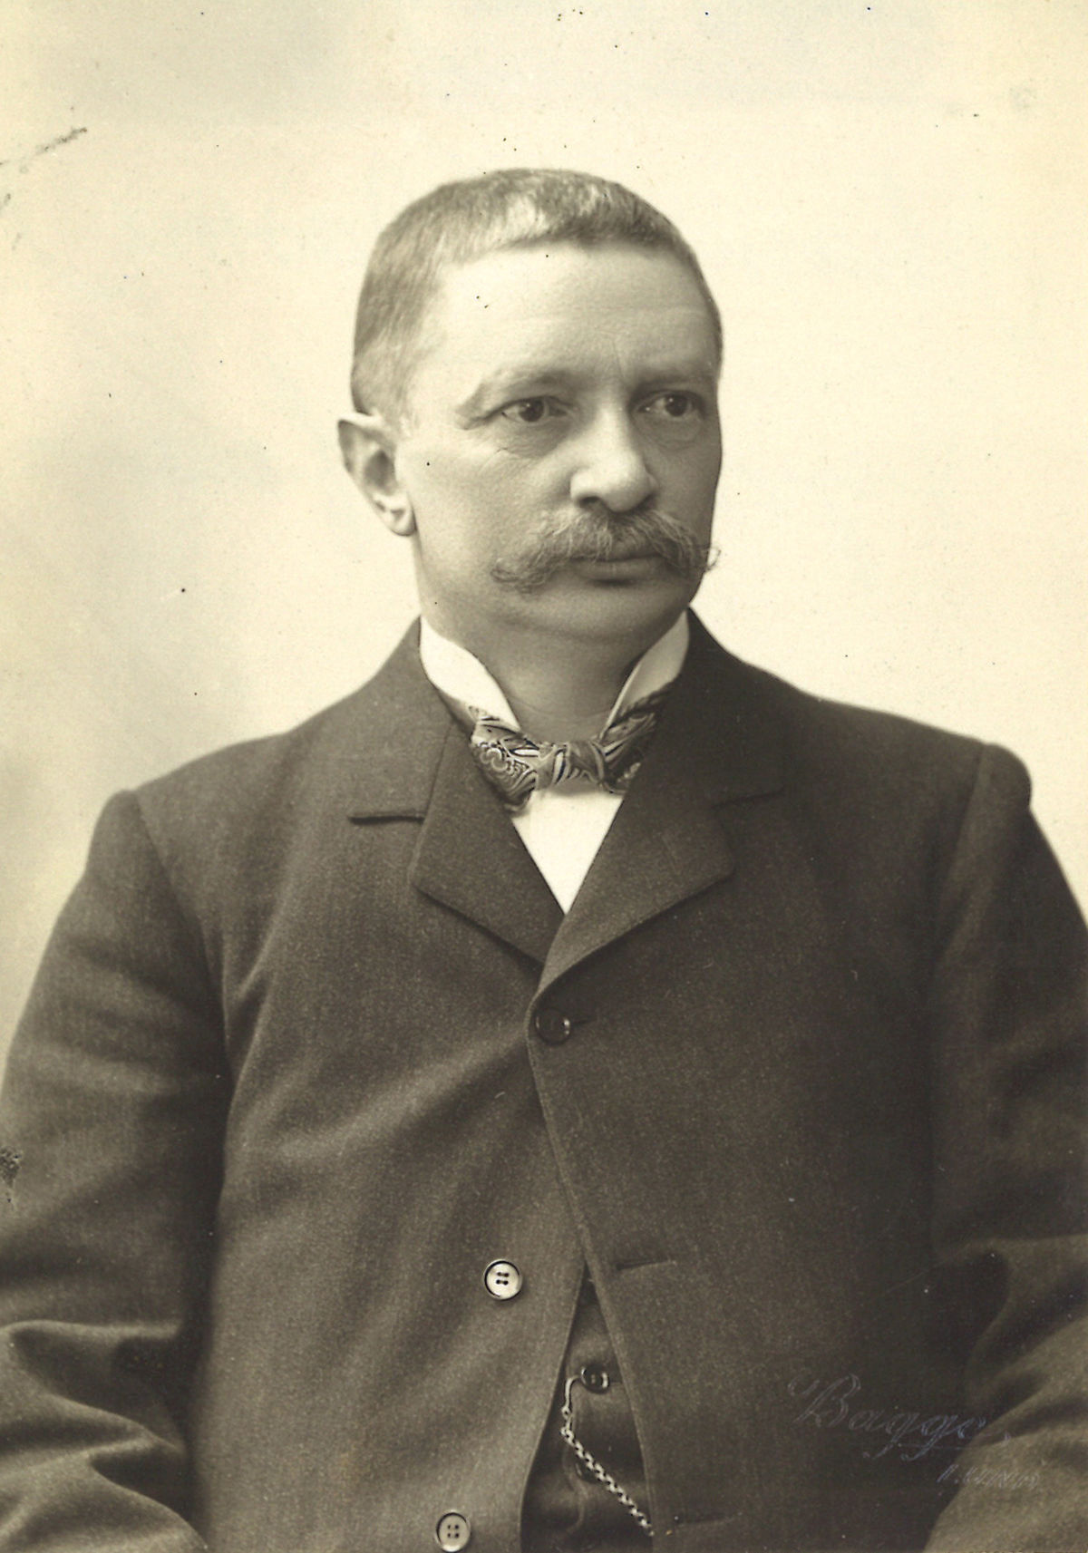
Identifying Gases: Rydberg’s Formula TODO
$$λ_{peak}=\frac{b}{T}≈\frac{0.002898}{T}$$
Actual Expression (by Differentiation + Lambert W):
$$λ_{max}=\frac{hc}{k_{B}\left(4.965114\right)T}$$
We have these values, luckily, so we can sub in
Precisely, $b=0.002897771955185172661 mK$
This gives us the domineering wavelength
Useful for determining colour.

Slide 21
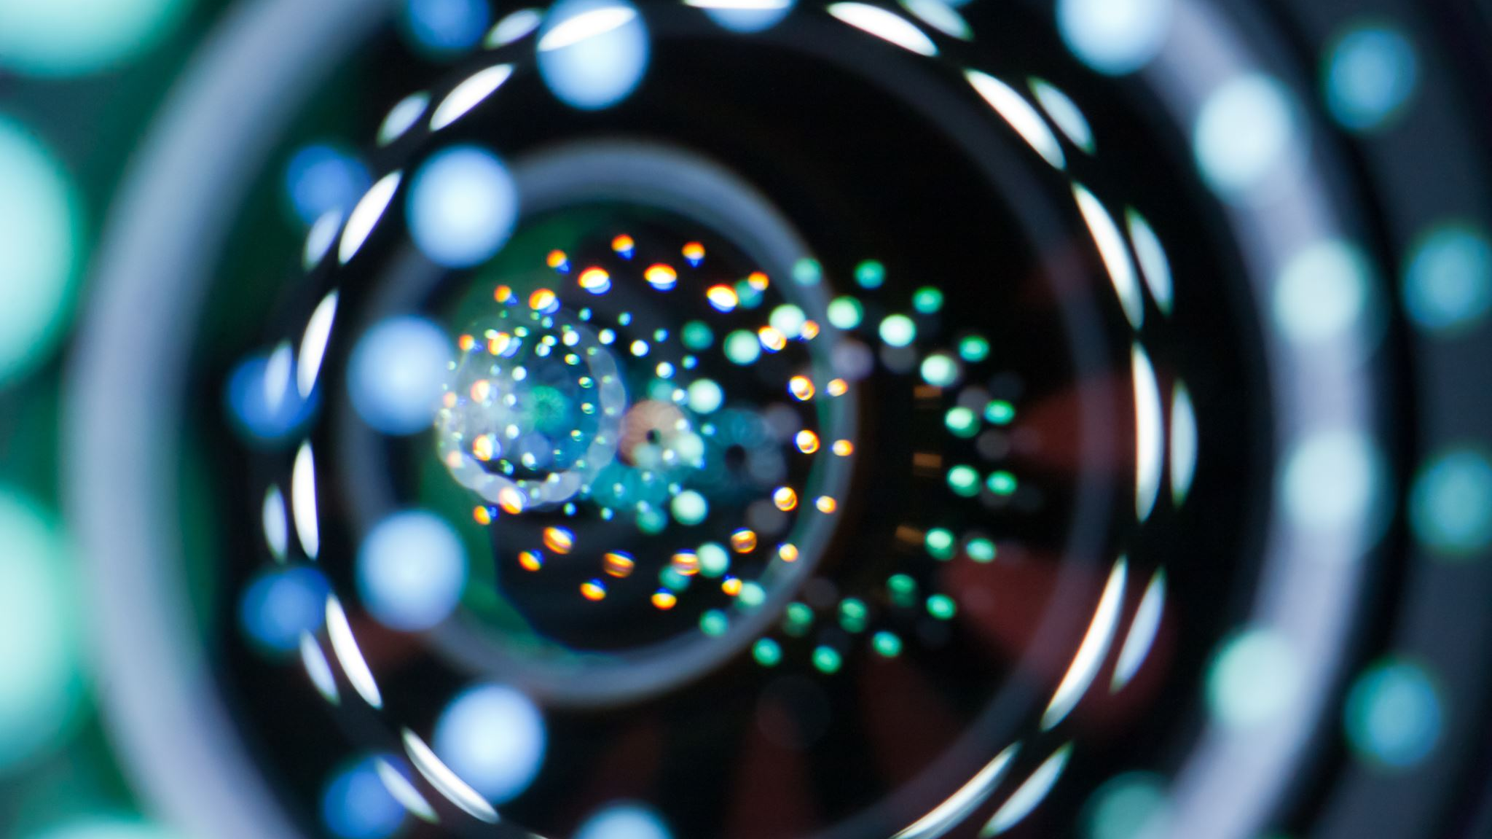
The Doppler Effect
2.1 The Original Doppler Effect
2.2 Redshift (and Blueshift)
2.3 Special Relativity and Doppler Effect

Slide 22
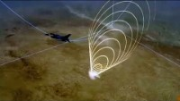

Slide 23
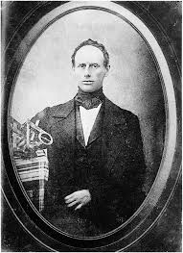
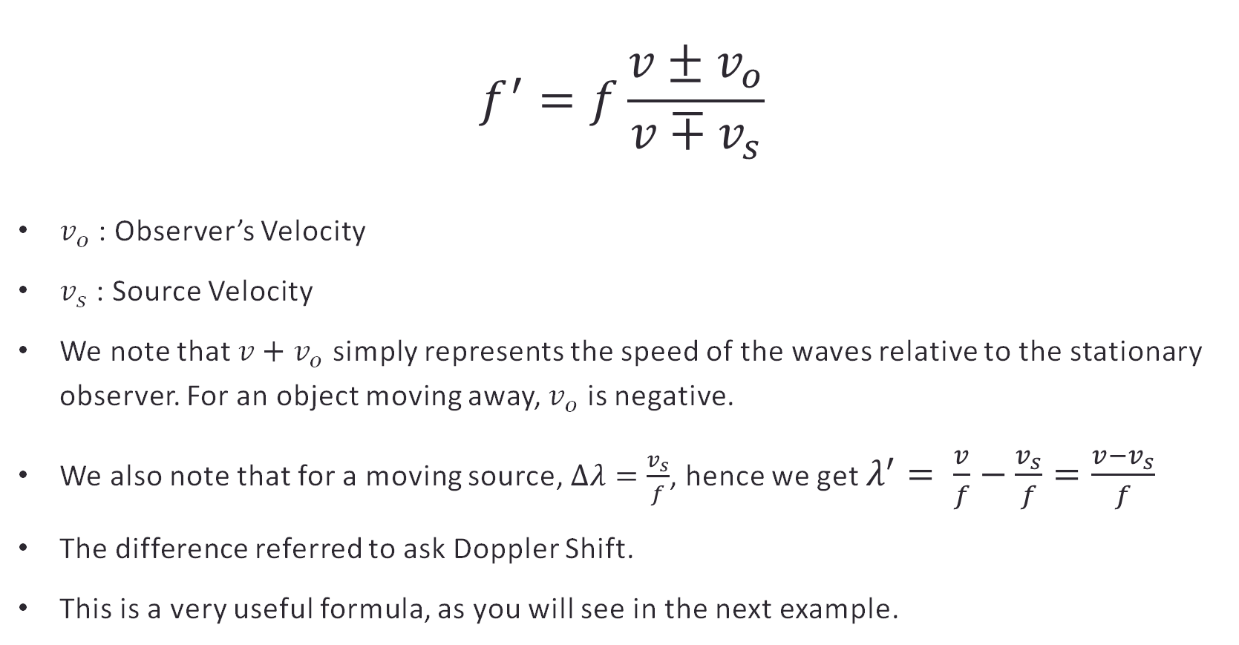
The Doppler Effect
$$f^{′}=f\frac{v±v_{o}}{v∓v_{s}}$$
$v_{o}$ : Observer’s Velocity
$v_{s}$ : Source Velocity
We note that $v+v_{o}$ simply represents the speed of the waves relative to the stationary observer. For an object moving away, $v_{o}$ is negative.
We also note that for a moving source, $Δλ=\frac{v_{s}}{f}$, hence we get $λ^{′}= \frac{v}{f}−\frac{v_{s}}{f}=\frac{v−v_{s}}{f}$
The difference referred to ask Doppler Shift.
This is a very useful formula, as you will see in the next example.

Slide 24
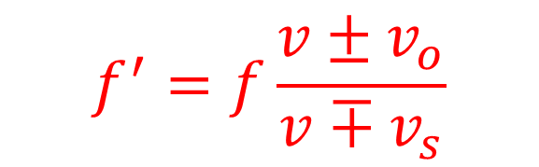
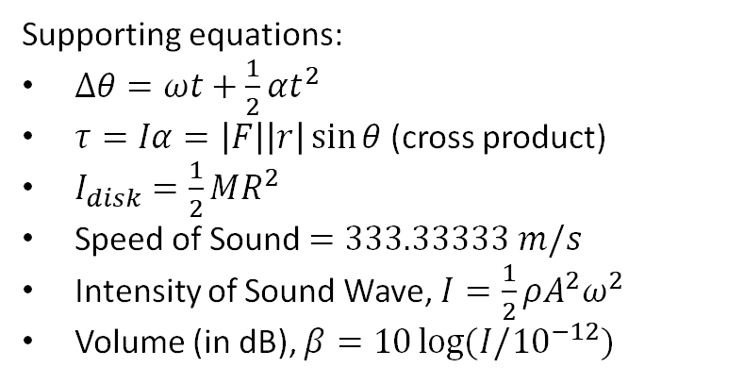
Question
Let's say there is a massless object that emits a sound of frequency 200 Hz and amplitude 0.2 cm and is conditioned to do so in one direction. This is now placed (switched on) at the edge of a 15kg pottery disc of radius 2.0m rotating originally at 5.0 rad/s, where the object now sends off a sound tangentially to the circle. A force of 40 N is exerted on the edge of the disc (tangent to the disk, parallel to the radius) for 1 second and then the object is switched off. Given that at the very moment when the object is placed, a listener stands 15 metres away from the object and, at that moment, he is in the direction of the sound. What is the maximum level of sound (in dB) that he can hear, given the density at the auricle is 2.04 g/cm^2 and that there is no amplification by the pinna.
Supporting equations:
$Δθ=ωt+\frac{1}{2}αt^{2}$
$τ=Iα=\left|F\right|\left|r\right|\sin{θ}$ (cross product)
$I_{disk}=\frac{1}{2}MR^{2}$
Speed of Sound $=333.33333 m/s$
Intensity of Sound Wave, $I=\frac{1}{2}ρA^{2}ω^{2}$
Volume (in dB), $β=10\log{(I/{10}^{−12})}$
$$f^{′}=f\frac{v±v_{o}}{v∓v_{s}}$$

Slide 25
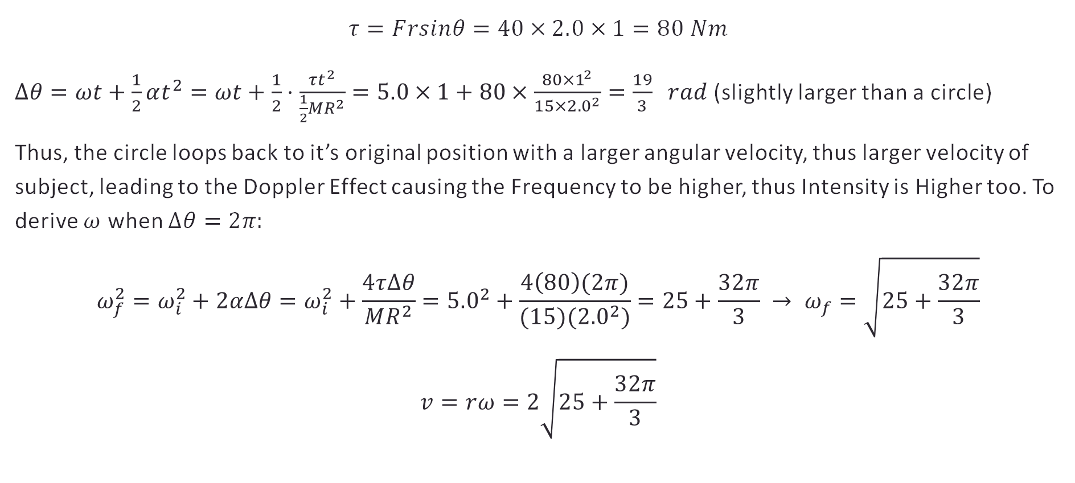
Answer (Part 1, Rotation)
$$τ=Frsinθ=40×2.0×1=80 Nm$$
$Δθ=ωt+\frac{1}{2}αt^{2}=ωt+\frac{1}{2}⋅\frac{τt^{2}}{\frac{1}{2}MR^{2}}=5.0×1+80×\frac{80×1^{2}}{15×{2.0}^{2}}=\frac{19}{3} rad$ (slightly larger than a circle)
Thus, the circle loops back to it’s original position with a larger angular velocity, thus larger velocity of subject, leading to the Doppler Effect causing the Frequency to be higher, thus Intensity is Higher too. To derive $ω$ when $Δθ=2π:$
$$ω_{f}^{2}=ω_{i}^{2}+2αΔθ=ω_{i}^{2}+\frac{4τΔθ}{MR^{2}}={5.0}^{2}+\frac{4\left(80\right)(2π)}{(15)({2.0}^{2})}=25+\frac{32π}{3} → ω_{f}=\sqrt{25+\frac{32π}{3}}$$
$$v=rω=2\sqrt{25+\frac{32π}{3}}$$

Slide 26
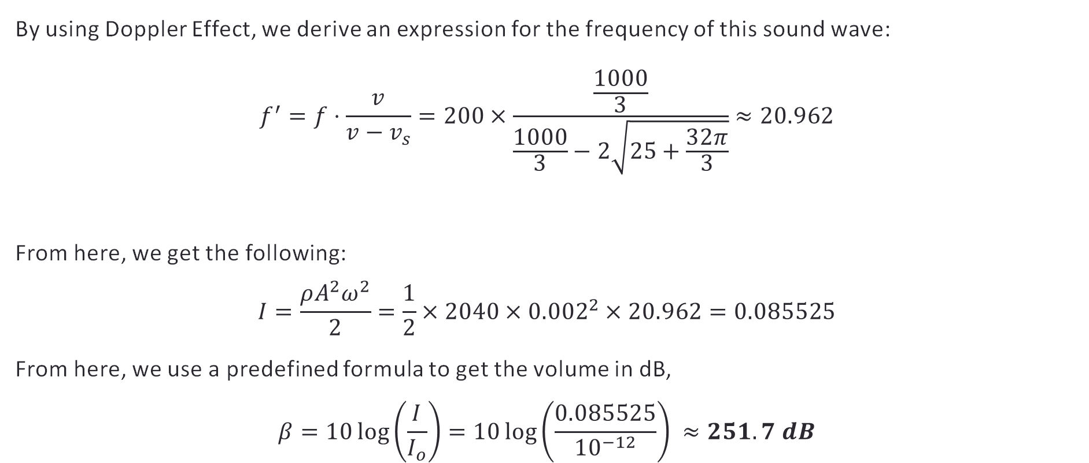
Answer (Part 2, Doppler Shift)
By using Doppler Effect, we derive an expression for the frequency of this sound wave:
$$f^{′}=f⋅\frac{v}{v−v_{s}}=200×\frac{\frac{1000}{3}}{\frac{1000}{3}−2\sqrt{25+\frac{32π}{3}}}≈20.962$$
From here, we get the following:
$$I=\frac{ρA^{2}ω^{2}}{2}=\frac{1}{2}×2040×{0.002}^{2}×20.962=0.085525$$
From here, we use a predefined formula to get the volume in dB,
$$β=10\log\left(\frac{I}{I_{o}}\right)=10\log\left(\frac{0.085525}{{10}^{−12}}\right) ≈251.7 dB$$

Slide 27
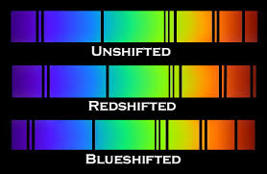
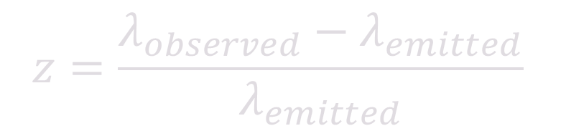
Redshift and Blueshift
When observing light, we often encounter redshift and blueshift based on the movement of the DSO relative to the observer
DSO moves → Doppler Shift → Frequency Changes → Wavelength Changes → Colour of Light Changes
This is observed in the form of absorption and emission spectra being shifted.
Source moving away → Wavelength Increases → Redshift
Source moving closer → Wavelength Decreases → Blueshift
$$z=\frac{λ_{observed}−λ_{emitted}}{λ_{emitted}}$$

Slide 28
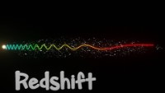
Relativistic Doppler Effect and Redshift

Slide 29
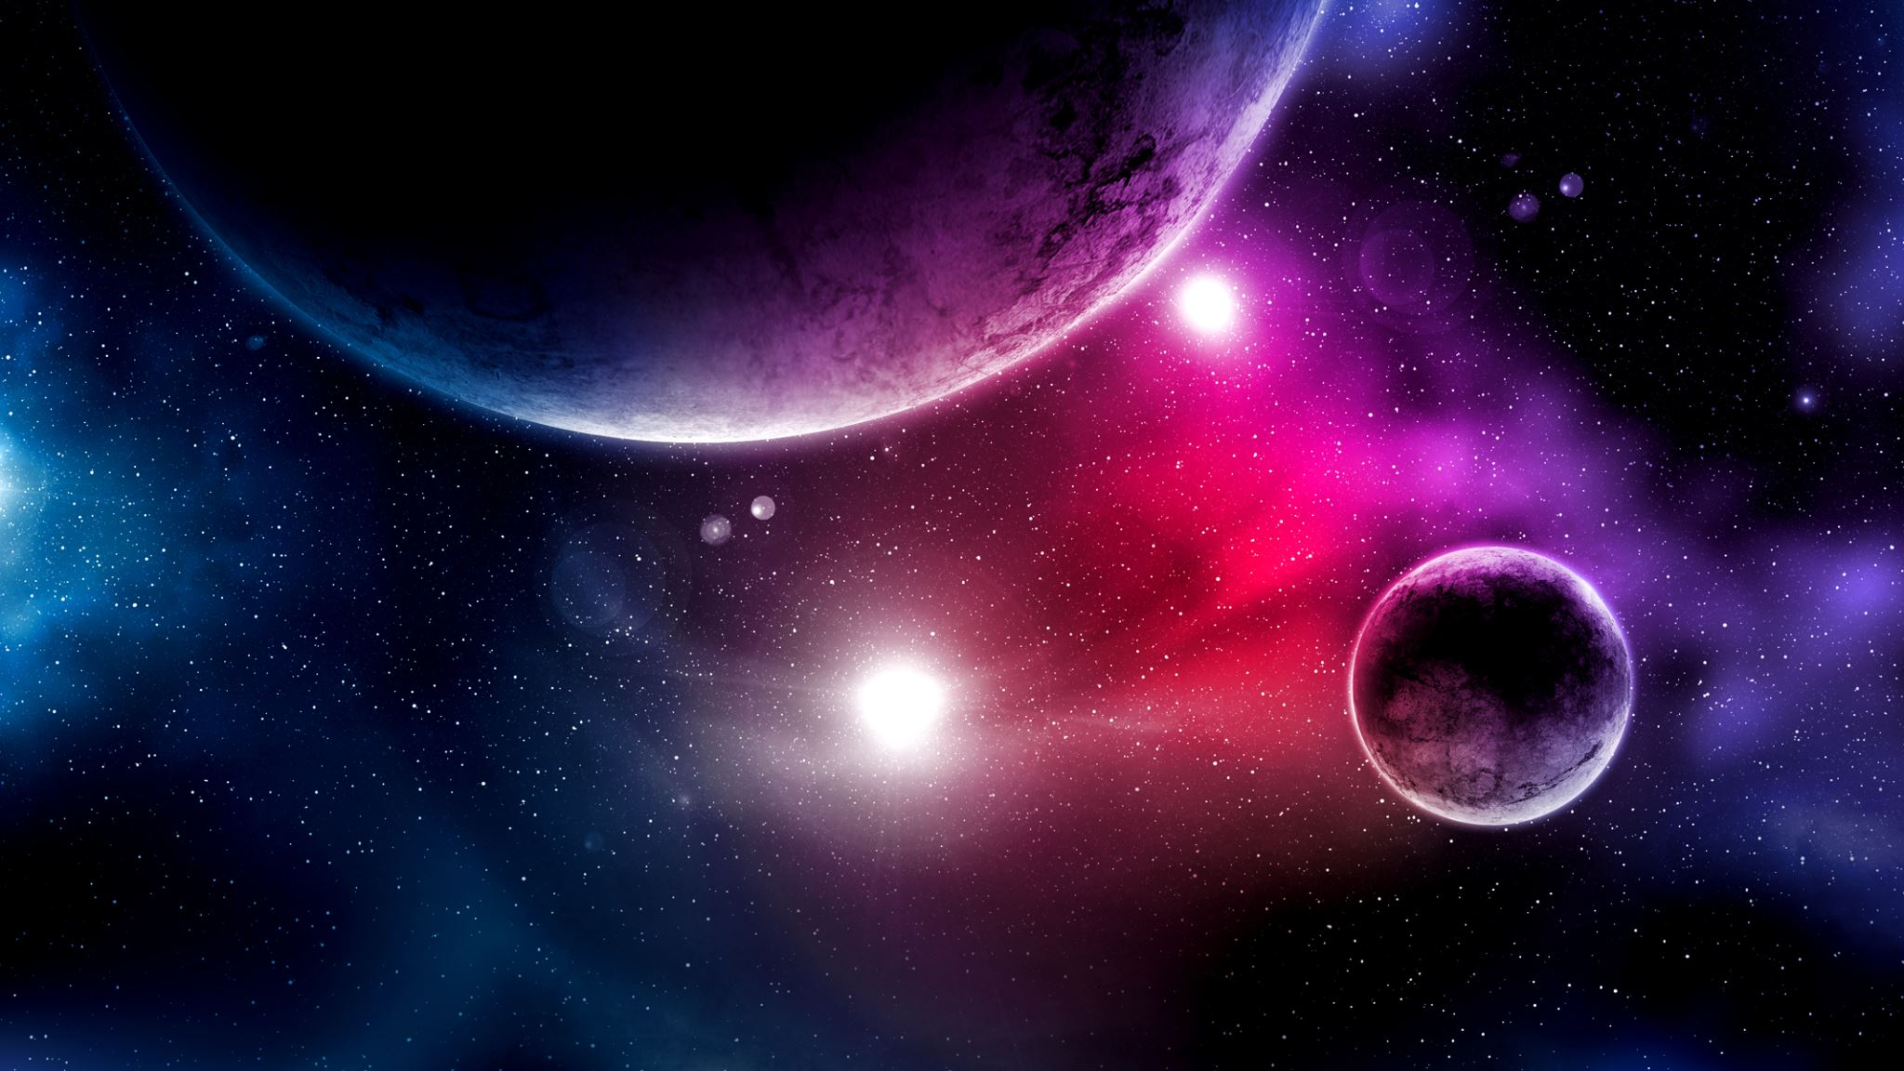
Doppler Spectroscopy: Hunting for Exoplanets
3.1 Radial Velocity Proposition
3.2 Gravitational Wobble
3.3 The Doppler Shift

Slide 30
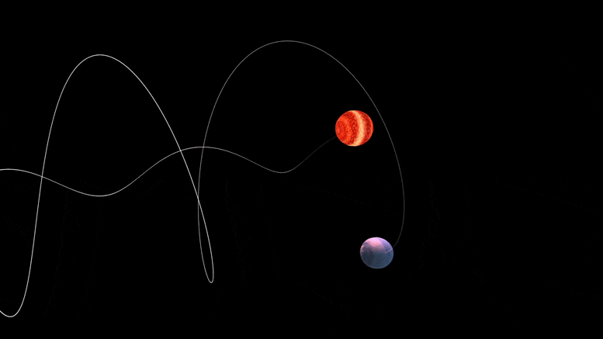
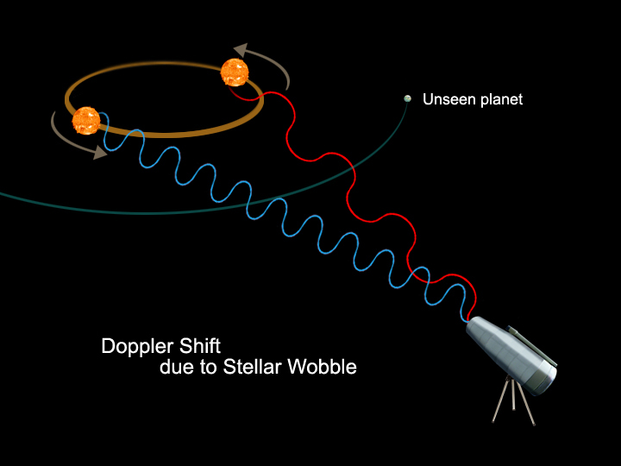
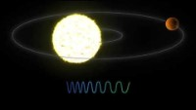
Stellar Wobble
In orbit, planet and star orbit about fixed centre of mass (conserved angular momentum)
Usually this fixed centre of mass is very close to the star, hence the star only rotates about a small orbit.
Star moves slightly closer and further to us (Stellar Wobble)
Doppler Shift (slight variation in spectral lines)

Slide 31
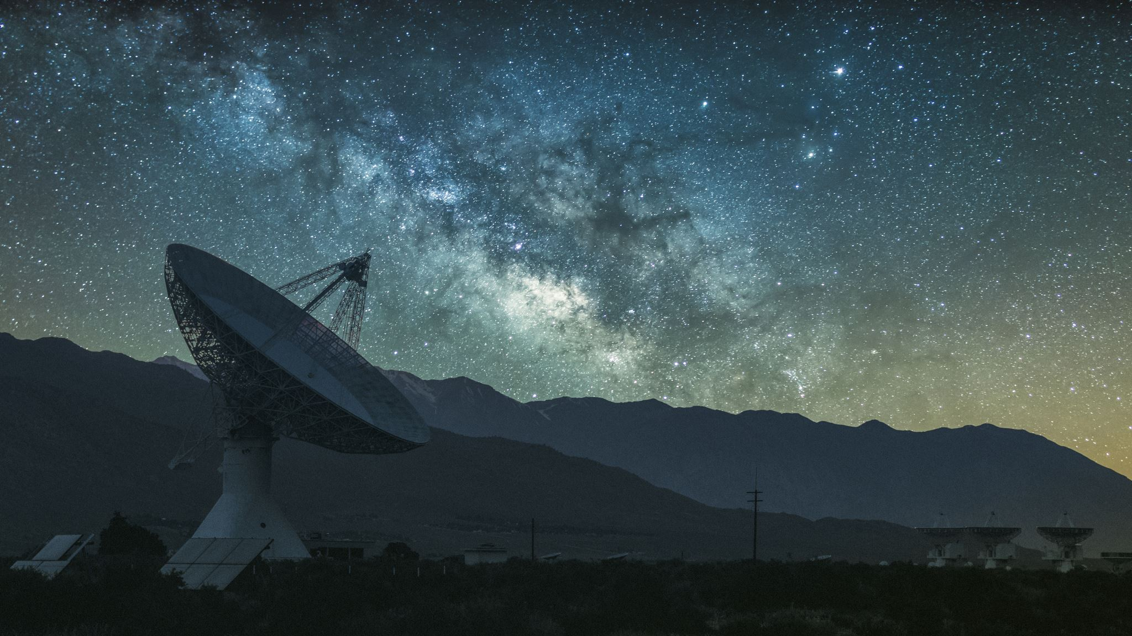
This marks The End Of This Presentation.
Thank you for listening to the Astronomy Senior Club Theory Session. We hope to get more content to you soon.

